Slide 1
Human-Environment Interaction of Latin America

Slide 2
-slash-and-burn: the process of cutting trees and grasses and burning the debris to clear the field for farming
-After a few years, the soil becomes exhausted, all nutrients from the soil are gone

Slide 3
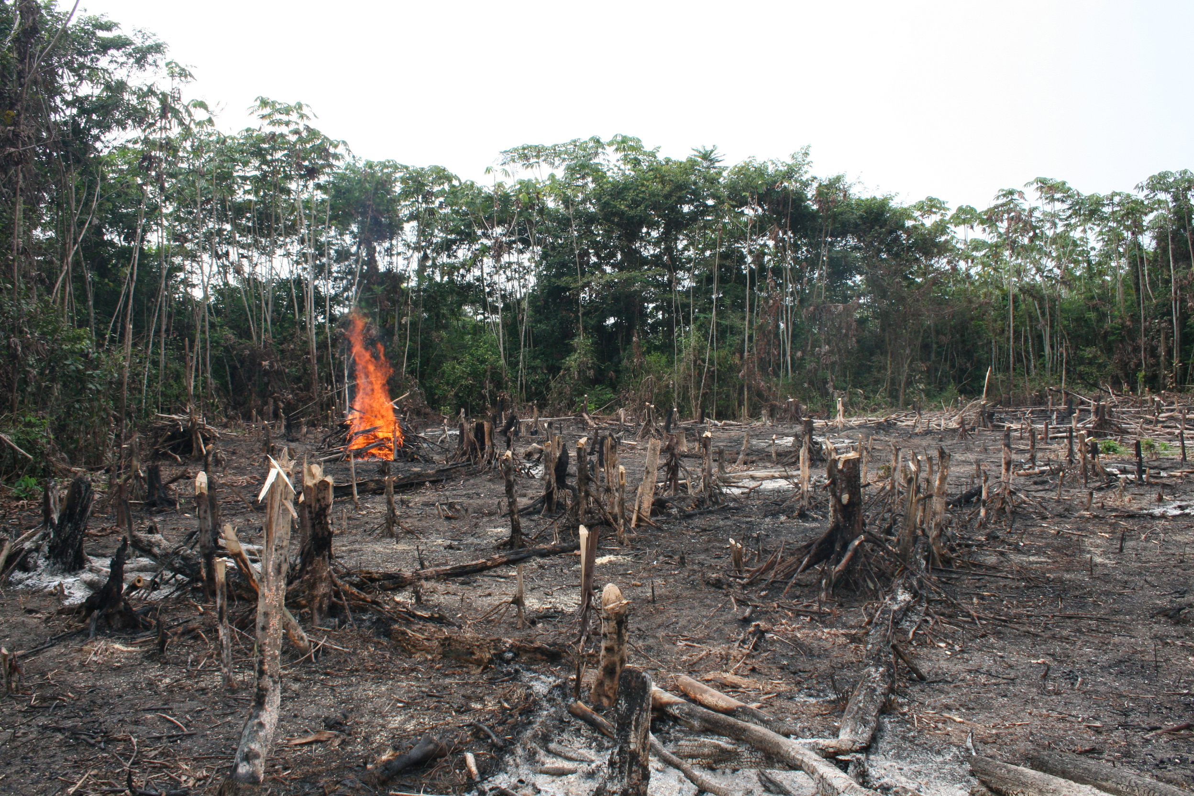

Slide 4
-terraced farming: an ancient technique of farming for growing crops on mountain slopes
-Uses step-like horizontal fields cut into the slopes
-Reduces soil erosion
-Practiced by the Inca and Aztecs

Slide 5
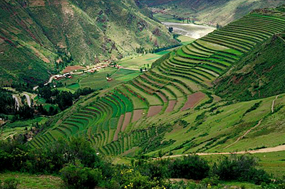

Slide 6
-infrastructure: basic support systems in a society like power, transportation, water, sanitation, and education systems
-Many rapidly growing cities in Latin America cannot provide proper infrastructure, creates problems
-Examples of problems: shortages of drinking water, high unemployment, increased crime

Slide 7
Advantages of Tourism
-Resorts provide jobs for local residents
-Restaurants, tours, excursions bring money into areas
Disadvantages of Tourism
-Congestion and pollution increases
-Obvious gap between wealthy tourists and less wealthy residents
-Owners of resorts don’t bring money back into the community

Slide 8
Mexico

Slide 9
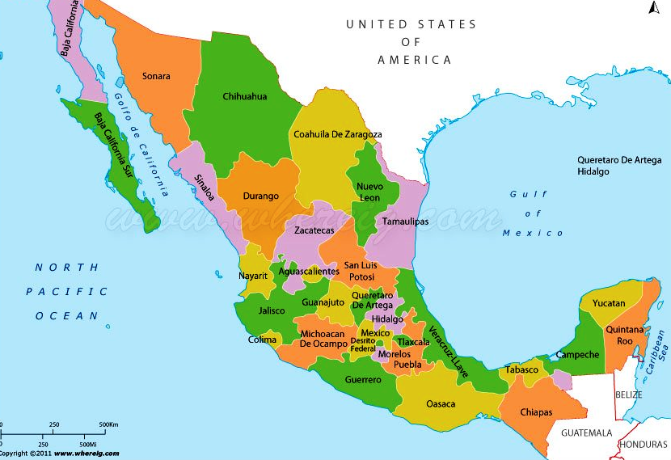

Slide 10
-Spanish conquest: conquering of Native groups by the Spanish in Mexico
-1519: Hernan Cortés and his men arrived on the coast of Mexico
-Marched into the interior until they reached Tenochtitlán

Slide 11
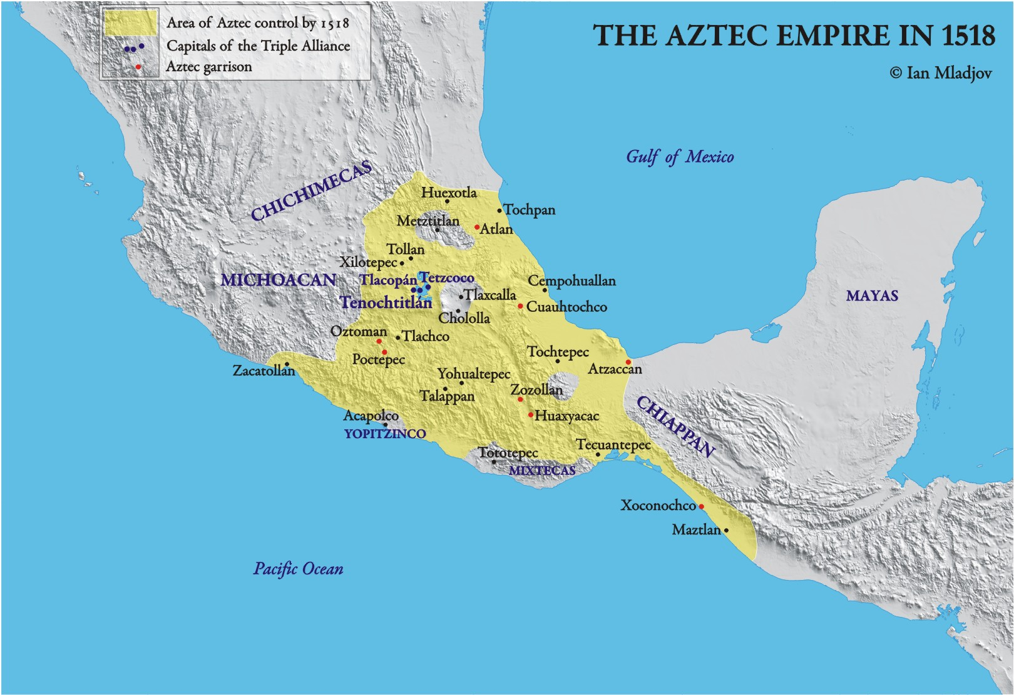

Slide 12
-Tenochtitlán: capital of the Aztec empire
-Empire was completely conquered by 1521
-Mexico was now part of the Spanish empire
-Gained independence in 1821

Slide 13
Economy of Mexico
-The oil industry is an extremely important part of the economy of Mexico
-Reserves located in the Gulf of Mexico

Slide 14
-Manufacturing is another important industry
-maquiladoras: factories that assemble imported materials into finished products that are exported
-Usually exported to the United States

Slide 15
-Mexico is an important member of NAFTA
-NAFTA (North American Free Trade Agreement): trade agreement creating a zone of cooperation on trade between Canada, the United States, and Mexico

Slide 16
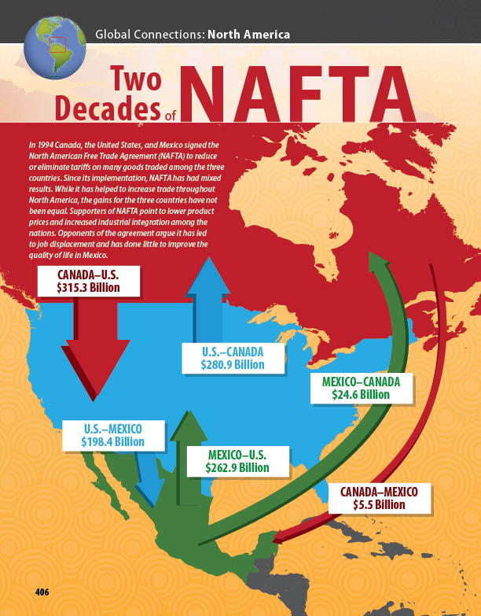

Slide 17
-A rapidly growing population has led to a shortage of jobs
-Immigration to the United States has impacted Mexican society
-Many workers make money in the United States and send funds back to families in Mexico

Slide 18
-Rates of children attending school has increased
-Education will become even more important as Mexico becomes more industrialized

